Slide 1

NLP SENTIMENT ANALYSIS
Data Science Project

Slide 2
OUR TEAM
Mentor : Sadiya Maam
Team Member’s Names :
Rhucha Dhawale
Santhosh Chinnandi
Sharmila M
Aravind Bommena
Chandoj Rishikesh Chary
Mohamed Matheen S M

Slide 3

PROJECT OBJECTIVE
Analyze customer reviews using NLP techniques.
Perform text preprocessing and feature extraction.
Build machine learning models for sentiment classification.
Compare model performance and identify the best classifier.

Slide 4
DATASET & PROBLEM STATEMENT
Input data contains customer reviews and ratings.
Goal: Predict sentiment from textual reviews.
Sentiment categories created using review ratings.
Binary and multiclass sentiment analysis performed

Slide 5
EXPLORATORY DATA ANALYSIS
• Analyzed review rating distribution.
• Identified most frequent words and bigrams.
• Studied review length patterns.
• Generated insights from customer review behavior

Slide 6
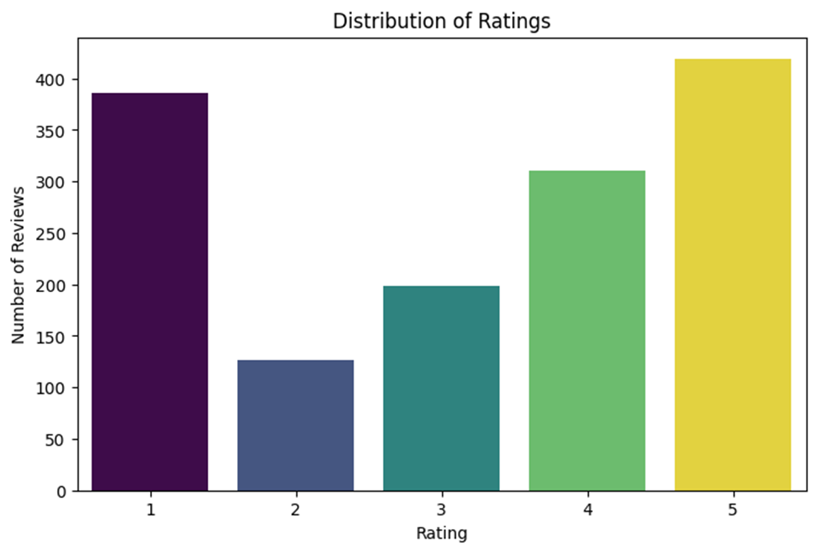
Distribution of Ratings

Slide 7
TEXT PREPROCESSING STEPS
•Handled missing and empty values.
•Combined text columns into a single review column.
•Removed emojis, non-ASCII characters, punctuation, and URLs.
•Converted text to lowercase.
Performed tokenization, stopword removal, and lemmatization

Slide 8
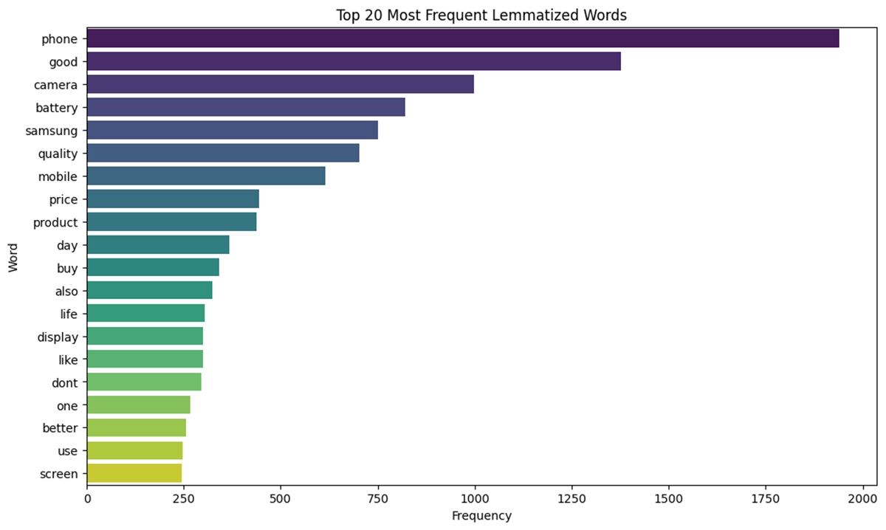
Most Frequent Words

Slide 9
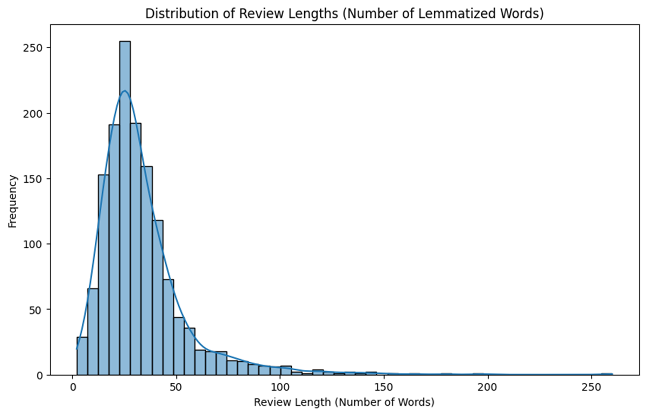
Review Length Analysis

Slide 10
FEATURE ENGINEERING
• Created sentiment labels from ratings.
• Applied Bag of Words and TF-IDF vectorization.
• Converted text into numerical representation.
• Prepared features for machine learning models.

Slide 11
MODEL BUILDING
Trained multiple machine learning models.
Algorithms used: Gradient Boosting, Random Forest, SVM, Logistic Regression.
Compared model accuracy and performance metrics.
Selected best-performing model for deployment

Slide 12
MODEL RESULTS
Gradient Boosting Accuracy: 74.6%
Random Forest Accuracy: 76.7%
SVM Accuracy: 80%+
SVM and Logistic Regression delivered the best performance

Slide 13
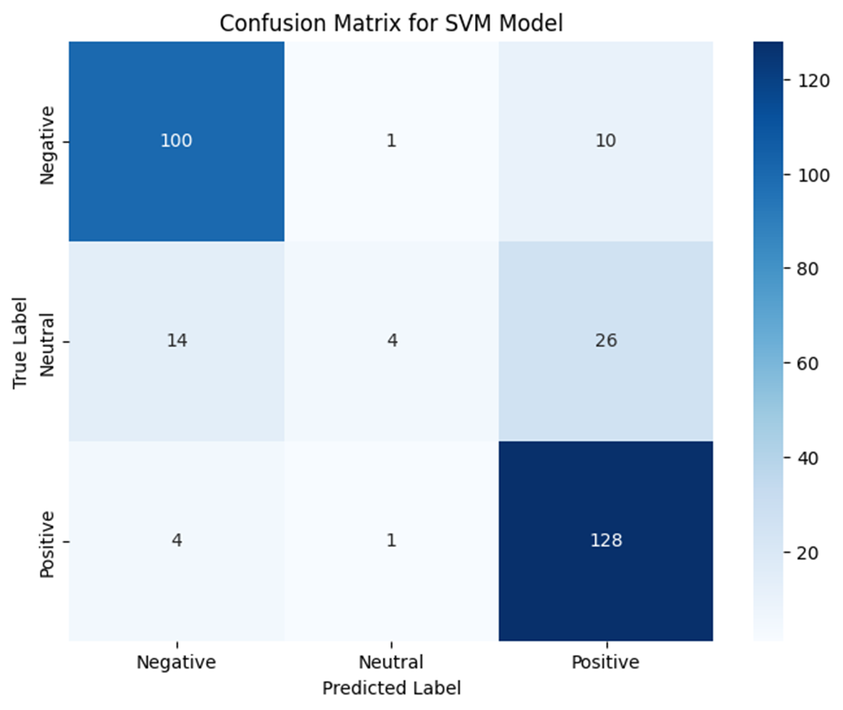
Initial SVM Model Performance

Slide 14
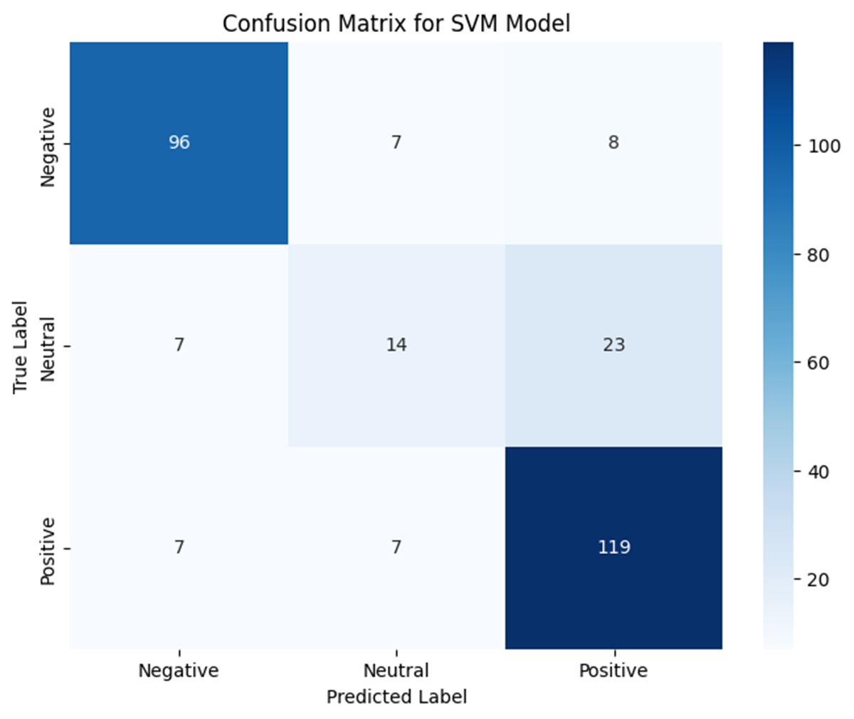
Improved SVM Model Performance After Tuning

Slide 15
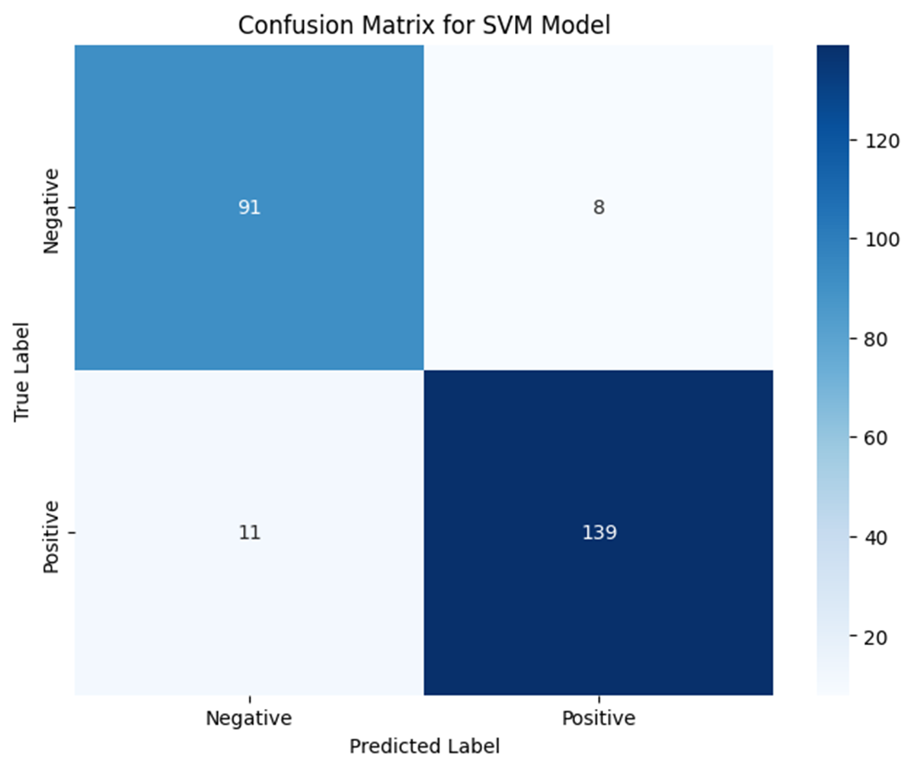
Binary Classification Accuracy

Slide 16
RESULTS & OBSERVATIONS
•SVM and Logistic Regression achieved the best performance.
•Binary sentiment classification improved overall accuracy.
•TF-IDF and Bag of Words produced similar feature dimensions.
•Preprocessing significantly improved text quality and model accuracy.

Slide 17
Streamlit Web Application
•Built a user-friendly Streamlit application.
•Users can enter reviews directly into the app.
•The system predicts sentiments instantly.
Supports both binary and multi-class sentiment prediction

Slide 18
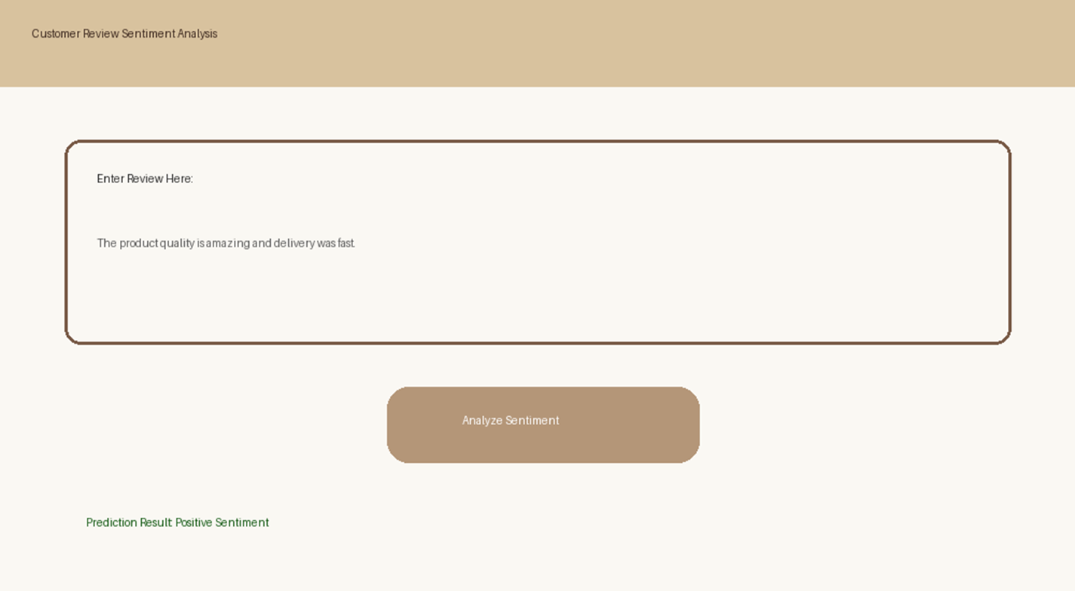
Streamlit Application

Slide 19
THANK YOU

